Slide 1



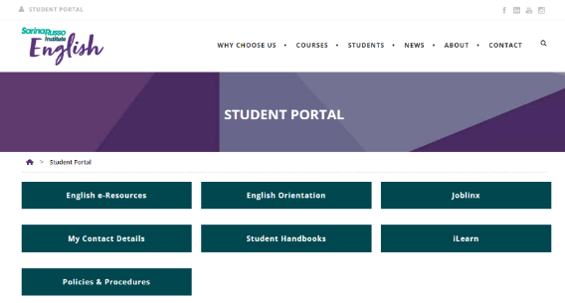





Slide 2




^{Open the Student Portal}
^{Click on English Orientation}

Slide 3



Slide 4
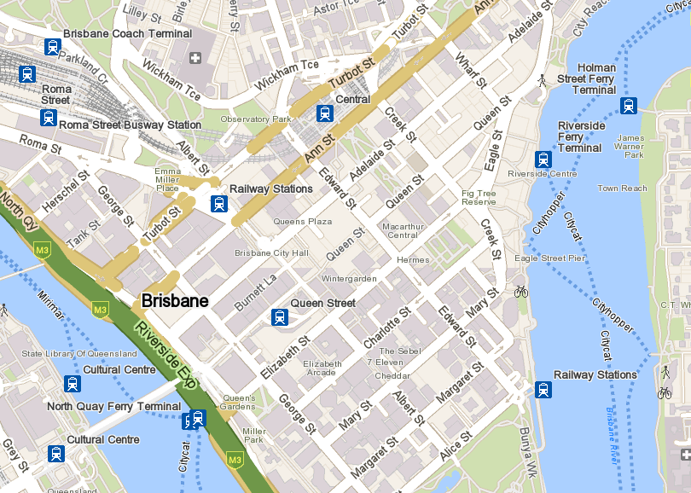



You are here
click for
Google Maps
^{BRISBANE CBD}

Slide 5
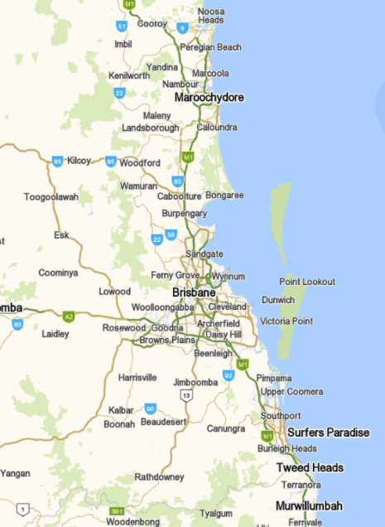

click for
Google Map

Slide 6
Fares have been reduced across public transport to a 50 cent flat rate trial across all zones and modes on the Translink network across Queensland.
click for
Translink info
^{BRISBANE TRANSPORT}

Slide 7
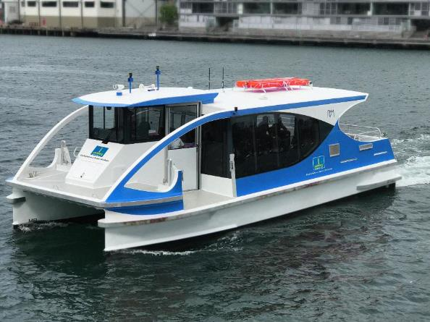

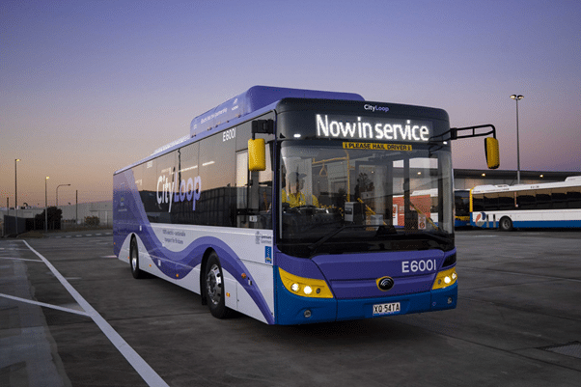


click for
CityHopper info
FREE services
CityHopper Ferry, Spring Hill Loop and City Loop buses
click images for info
click for
City Loop info
^{BRISBANE TRANSPORT}

Slide 8

Courses at
Options for students:
Homestay with an Australian family
Specialist student accommodation
  Student One, Scape, Iglu, Uniresort, UniLodge, Urbannest
Privately rented accommodation
(house or apartment)
  There are laws for renting in Queensland to protect you – always rent legally! See the RTA link below.
click images for info
^{BRISBANE TRANSPORT}

Slide 9
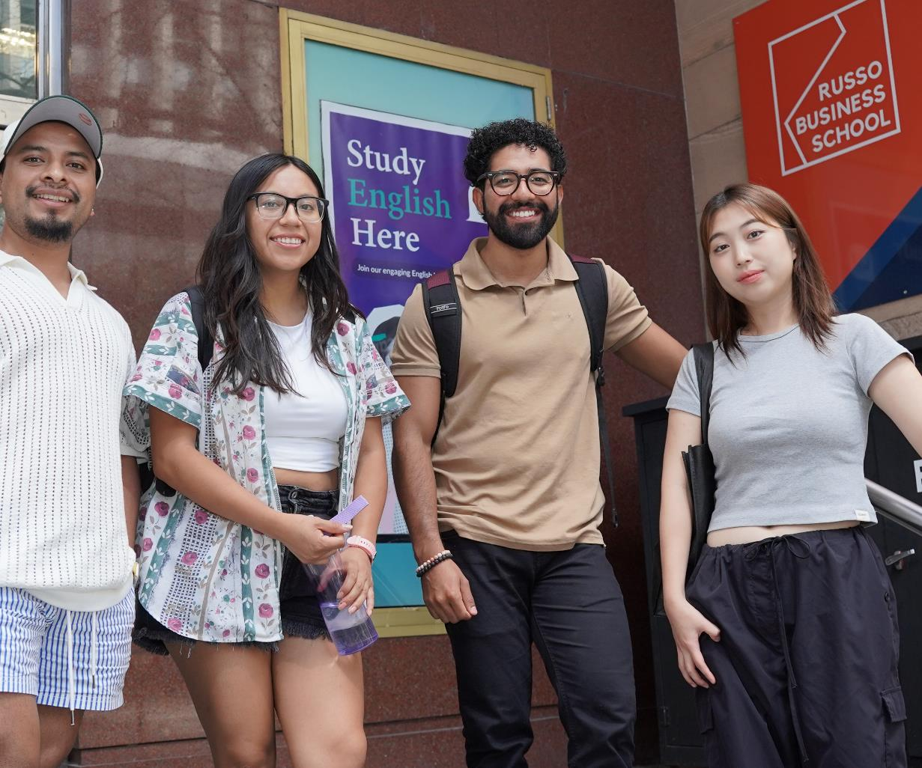
Courses at

Slide 10
Levels and Courses
EACH LEVEL = 10 WEEKS
Level | Course/s
Advanced/Mastery | IELTS Preparation
Mastery | BEEP – Bridging English Entry Program
Advanced | Unipath 2 Intensive General English IELTS Preparation - ADV
Upper-Intermediate | Unipath 1 Intensive General English IELTS Preparation - UPP
Intermediate | Unipath 1 Intensive General English
Pre-Intermediate | Intensive General English
Elementary | Intensive General English

Slide 11
  Learn how English works in a variety of contexts
  Cover all skills: grammar, reading, writing, speaking, listening, vocabulary
  Timetable:
    8.30am - 1.00pm Monday to Friday
    4.15pm - 9.30pm* Monday to Thursday*
Intensive General English

Slide 12



  Practice all academic skills including grammar, reading, writing, vocabulary and listening
  Your 25 hour per week course consists of:
  20 contact hours (in class) per week
  5 hours per week of self-study using
  online and grammar resources
  Timetable: 8.30am - 1.00pm
  Monday to Friday
Unipath English 1 & 2 (UPE 1&2)

Slide 13
  Focus on the academic skills of reading, writing, listening & speaking
  For students entering Masters programs
  20 hours face to face + 5 hours self-study
  Self-study: grammar homework and reading preparation
  Timetable: 8.30am – 1.00pm Monday to Friday
Bridging Entry English Program (BEEP)

Slide 14
  Focus on preparation for an IELTS test for university entry or visa purposes
  Extensive test preparation and weekly mock tests
  20 hours face to face
  Timetable: 4.15 - 9.30pm
  Monday to Thursday
IELTS
Preparation & Advanced

Slide 15

English Timetable AM
Night classes now available
  Our face-to-face classes are scheduled for 20 hours per week plus option classes
  Monday to Friday
8.30-10.30am | 11.00am-1.00pm | 1.10-2.00pm
Class session 1 | Class session 2 | Free electives/ support classes*
  * See schedule for additional FREE classes

Slide 16
English Timetable PM
  Our face-to-face classes are scheduled for 20 hours per week plus option classes
  Monday to Thursday
1.10pm-2.00pm | 4.15pm-7.15pm | 7.30pm-9.30pm
Free electives/ support classes* | Class session 1 | Class session 2
  * See schedule for additional FREE classes

Slide 17
Course progress and assessment
  We record the results and average over the 10 weeks of each level
  You should complete all class work, tests and homework to maintain satisfactory course progress
COURSE PROGRESS AND ASSESSMENT

Slide 18

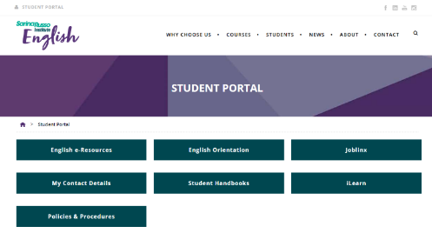
  Improve your language & communication skills
  Learn skills to enhance your job prospects - resume preparation, hospitality short courses, practice for job interviews
  Practice English for everyday life: work, travel & social
  Prepare for assessment tasks
  Complete your homework & ask questions
  Have fun, improve your confidence, make new friends!
Free elective/ support classes

Slide 19
  Intensive General English
  Requirements to pass the course:
  Attend 80% or more of classes
  Complete assessments weekly
  60% average in each skill = grade C on your certificate
    See your Student Handbook for further details
COURSE PROGRESS AND ASSESSMENT

Slide 20
  Unipath English 1 & 2
  Requirements to pass the course:
  Attend 80% or more of classes
  Complete assessments each weekly
    60% average in each of the skills Reading, Writing, Listening and Speaking.
  Complete 80% of Self-Study tasks as set by your teacher
    See your Student Handbook for further details
COURSE PROGRESS AND ASSESSMENT

Slide 21
  Bridging Entry English Program
  Requirements to pass the course:
  Attend 80% or more of classes
  Complete a range of formative and summative assessments throughout the course.
    60% average in each of the skills Reading, Writing, Listening and Speaking.
  Complete 100% Self-Study and Formative tasks to a satisfactory level
    See your Student Handbook for further details
COURSE PROGRESS AND ASSESSMENT

Slide 22


Extra
Activities

Slide 23
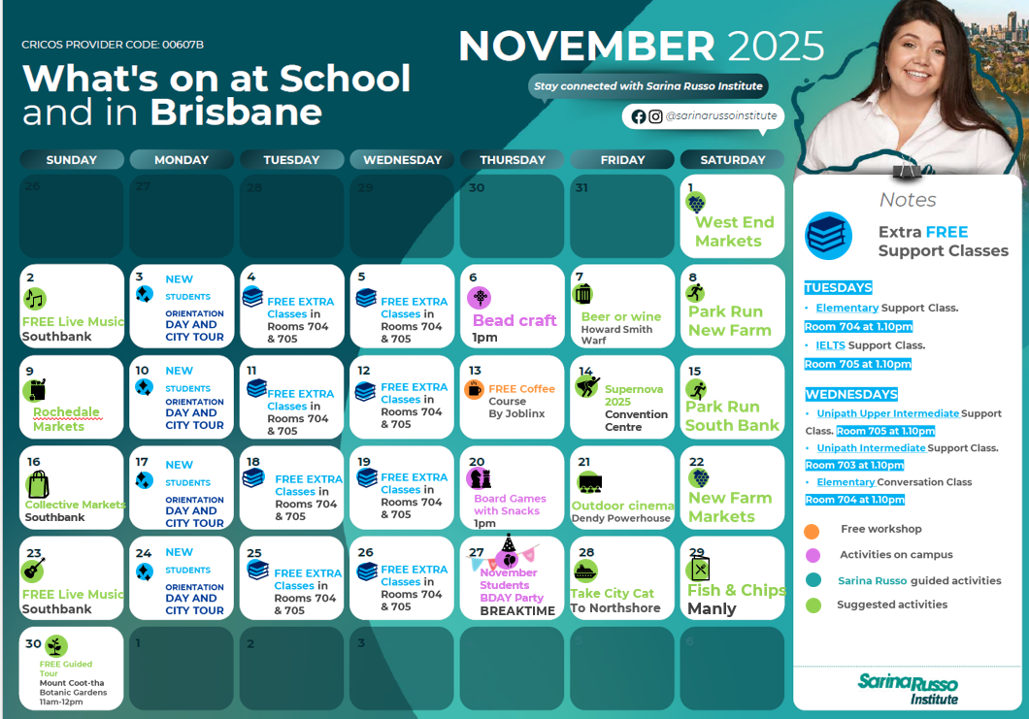


Slide 24


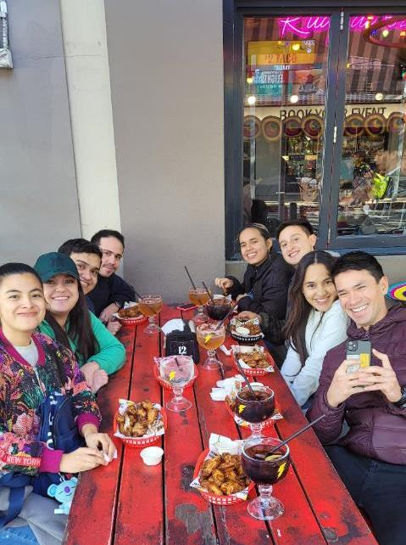
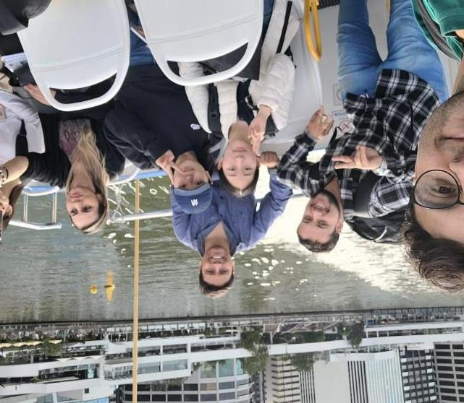
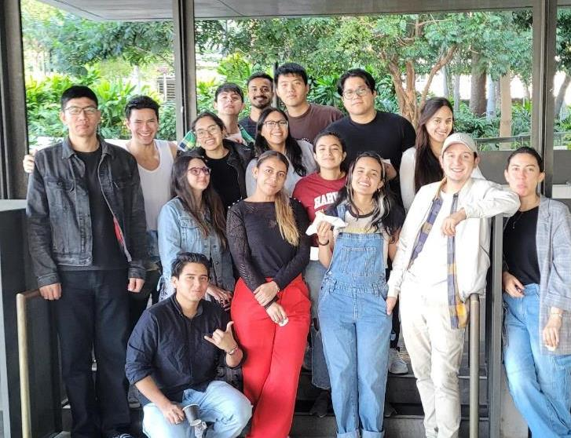
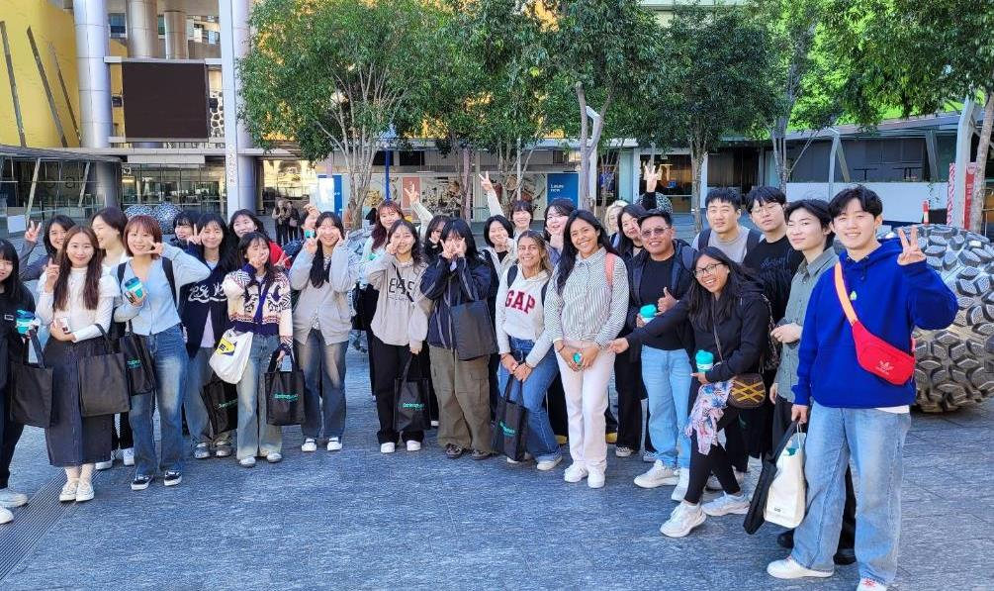
Some extra-class fun!

Slide 25

Join our Whatsapp group and don’t miss anything!

Slide 26

Institute and Visa information

Slide 27

All students should understand their visa conditions
Student visa conditions include:
Maintain a course of study (with CoE’s)
Maintain satisfactory attendance (above 80%)
Maintain satisfactory course progress
Work: up to 48 hours per fortnight (in study periods)
Provide your current address to your school
Have health cover (OSHC) for your visa period
VISA REQUIREMENTS

Slide 28



Elisapeta
AH HI
ENGLISH
Expiry: 21 Dec 2013
FULL TIME 80000

Slide 29

Other visas (Working Holiday, Student Dependent, Tourist): make sure you are aware of your visa conditions regarding Study and Work allowances
ALL VISAS: Make sure you know how long you can remain in Australia (your visa end date)
Click for info

Slide 30


UNACCEPTABLE CONDUCT INCLUDES:
Harassment of staff or other students
Threatening behavior
Sexual harassment
Bullying of staff or other students
Cheating or stealing
Bringing OR being under the influence of alcohol or drugs at school
Generally disruptive or inappropriate classroom behaviour including excessive mobile phone use
Misconduct may result in written warnings, suspension or cancellation of enrolment
For more information, check Policies & Procedures
CODE OF CONDUCT

Slide 31
To get the best out of your study, you should attend every lesson.
if you arrive late to class, or return late from breaks,
you may be marked absent
if you are sick for more than 2 days, see a doctor and
email your medical certificate to english@sri.edu.au
    If you will be away for a week or more due to illness or injury,
    contact us immediately, as we may need to SUSPEND your course
ATTENDANCE

Slide 32
Your teacher will record your attendance each day and your total course attendance will be monitored throughout the course.
below 80%: risk being reported to Dept of Home Affairs and having your enrolment and visa cancelled
All students on an academic pathway must complete each course or level with 80% minimum attendance otherwise you will NOT pass the course and progress to your next course
ATTENDANCE

Slide 33


Slide 34
Certificates are issued when you finish your course
ALL students, regardless of visa type, must have 80%+ attendance to receive a Certificate of Completion. Medical evidence may be considered when issuing certificates
Students with under 80% attendance will receive a Certificate of Partial Completion
If you complete more than one English course, all your certificates will be issued together after your final course
Students progressing to another course or University will require a final grade of C to pass
For more information on certificates and exit grades, see your Student Handbook
COURSE COMPLETION AND CERTIFICATES

Slide 35
If you have a problem or complaint, we are here to assist!
1. Always speak to your teacher first
IF UNHAPPY
2. Email English@sri.edu.au
IF UNHAPPY
3. Email CEO at English@sri.edu.au
IF UNHAPPY
4. Contact Overseas Student Ombudsman
www.oso.gov.au
For more information, see the Complaints & Appeals
section of your Student Handbook on the website
COMPLAINTS AND APPEALS

Slide 36

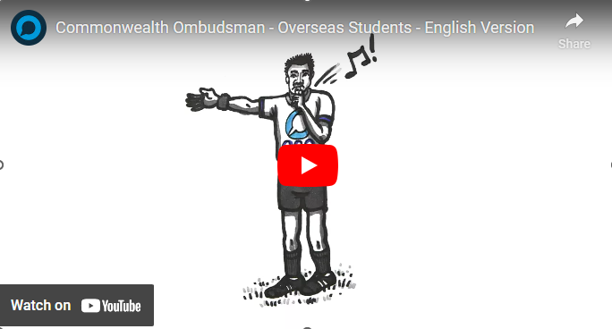
External appeals (International Students)
    Overseas Student Ombudsman
    www.ombudsman.gov.au
COMPLAINTS AND APPEALS

Slide 37




Email: English@sri.edu.au
Include:
Your full name
Student ID
Your question or request (appointment, document, problem)
Check your email for a reply
CONTACTING US

Slide 38

Meet our Academic Coordinator:
Naomi
Talk about challenges relating to class
Discuss your study goals/progress/pathway
Discuss attendance issues
Advice for health services and any other problems
Email english@sri.edu.au for an appointment

Slide 39
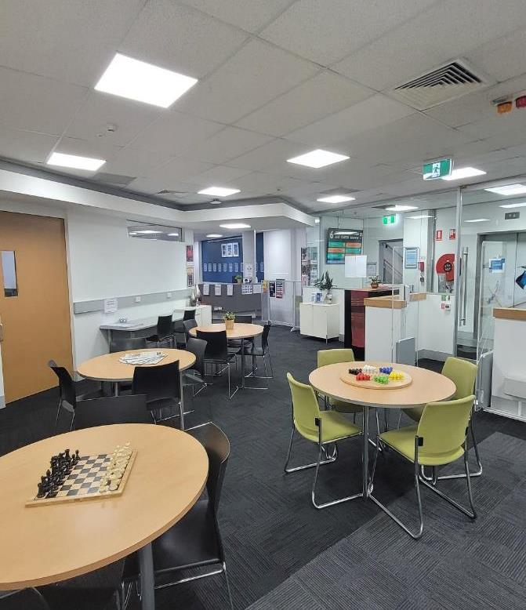
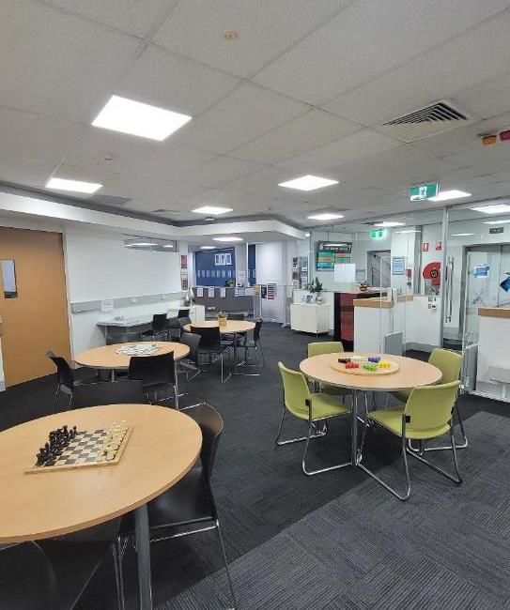
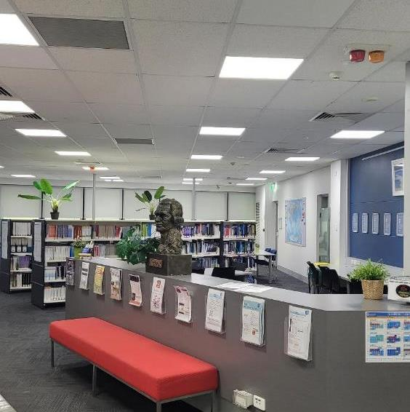
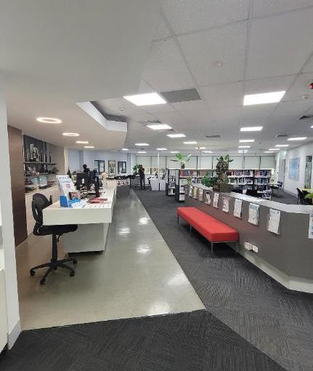

Available to all students on Level 2
Library (ID cards, printing, quiet study space)
Student Counsellor

Slide 40
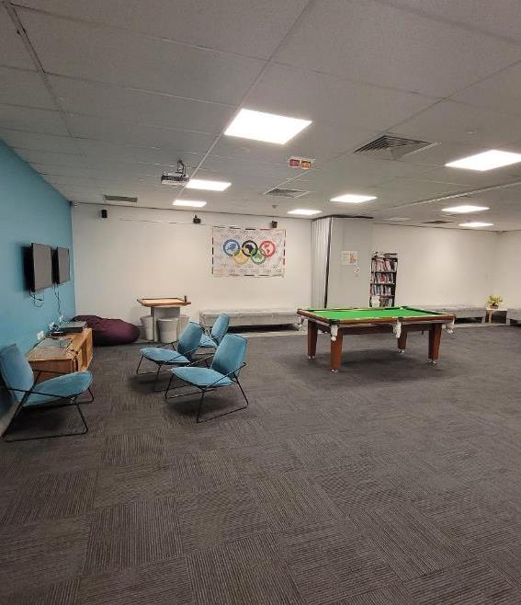
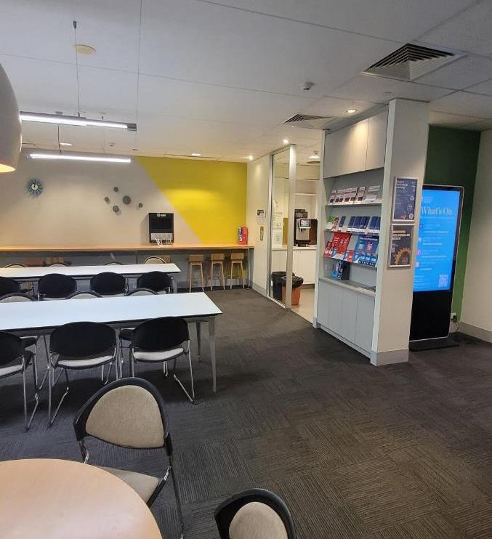
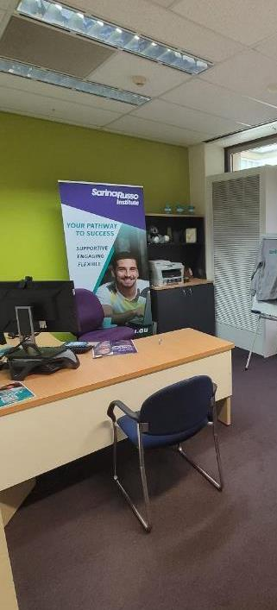
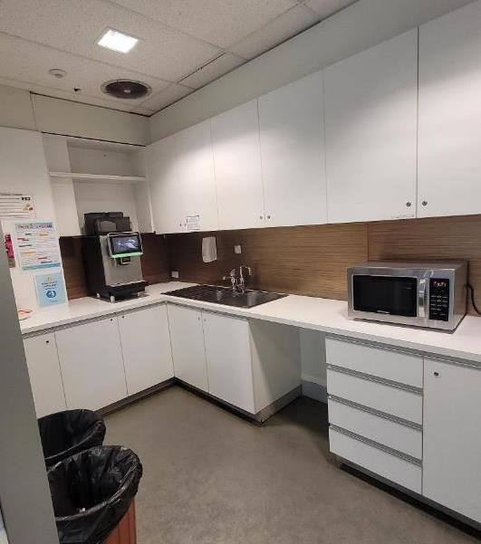
Student Facilities
Level 1:
  Student Lounge
  Kitchen and eating areas
  Vending machines
Level 2:
  Library, Counsellor, Joblinx
Level 5:
  Prayer room
Level 7:
  English noticeboard
  Kitchen
  English Office

Slide 41
Your Student ID
Print in the computer labs and library – see the library for details
Discounts: movies, tourist attractions
Please carry your ID every day
Elisapeta
AH HI
ENGLISH
Expiry: 21 Dec 2026
FULL TIME 80000

Slide 42

Health and safety

Slide 43

Safety in our buildings
349 Queen Street is open 7.30am-9.30pm Mon-Fri
Stairs are located at FRONT and REAR of the building.
TOILETS are located in the front stairwells,
disabled toilets are located on levels 1, 3, 4, 5
Emergency Evacuation signs - nearest exits
  Follow staff directions during an evacuation

Slide 44
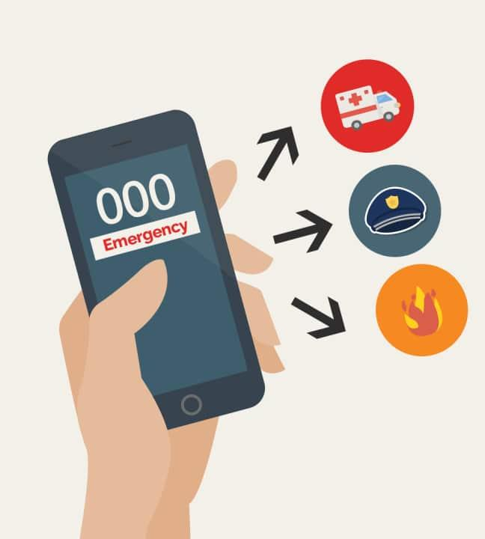
LEARN your ADDRESS and TELEPHONE number!
Ambulance
Police
Fire
EMERGENCY CONTACT

Slide 45
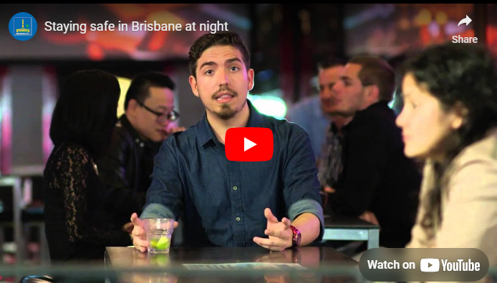
Personal Safety

Slide 46

Please be aware that laws in Australia may be different from your own country. Breaking the law in Australia may put your visa at risk.
Take particular care with:
Driving: make sure you have a VALID license to drive in Australia.
See Queensland Dept of Transport: http://www.tmr.qld.gov.au/Licensing/Getting-a-licence
Observe the road rules, especially regarding speed and drink driving; penalties are strict, especially during holidays.
Alcohol and drug laws
Laws for minors (under 18 years) e.g: gambling, drinking
If you require legal assistance, you can contact your country’s consulate https://protocol.dfat.gov.au/Public/ConsulatesInAustralia/4
OR Legal Aid Queensland 1300 651 188
THE AUSTRALIAN LAW

Slide 47
What does OSHC cover?
OSHC insurers provide a range of different OSHC plans.
The compulsory minimum (basic) OSHC plan will usually cover:
Visits to the doctor (GP)
Some hospital treatments
Ambulance, and limited pharmaceuticals (medicines).
OSHC doesn’t cover treatments such as dental, optical or physiotherapy. You can purchase Extras OSHC from an OSHC provider if you want cover for these.
As an international student in Australia, you are required to have Overseas Student Health Cover (OSHC) for the entire duration of your study in Australia.
OSHC

Slide 48

If you are sick:
  See a GP (General Practitioner)
  or call the National Home Doctor Ph:13 SICK (137425) for a Dr to visit you.
  or contact Doctors on Demand for an online appointment www.doctorsondemand.com.au
  or go to the App Store.
ONLY go to a hospital for accidents or serious illness
Pharmacies (chemists):
  great place to ask for health advice and to buy medicines
  carry your medication prescription in English
First Aid is available at school

Slide 49

Look for ashtrays or designated smoking areas
If you smoke in a smoke-free area you can be fined on the spot ($250 or more)
Cannot smoke within 5 metres of a bus stop or anywhere on a train platform or ferry stop
No smoking in the Queen Street Mall
Smoking laws are strict throughout Australia and new laws have recently been introduced in Queensland
  Check here https://www.qld.gov.au/health/staying-healthy/atods/smoking/laws/index.html
SMOKING

Slide 50


Water coolers are in kitchens and throughout the building
Drink plenty of water during hot weather

Slide 51
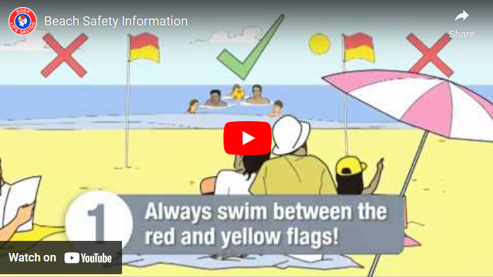
Staying safe at the beach

Slide 52
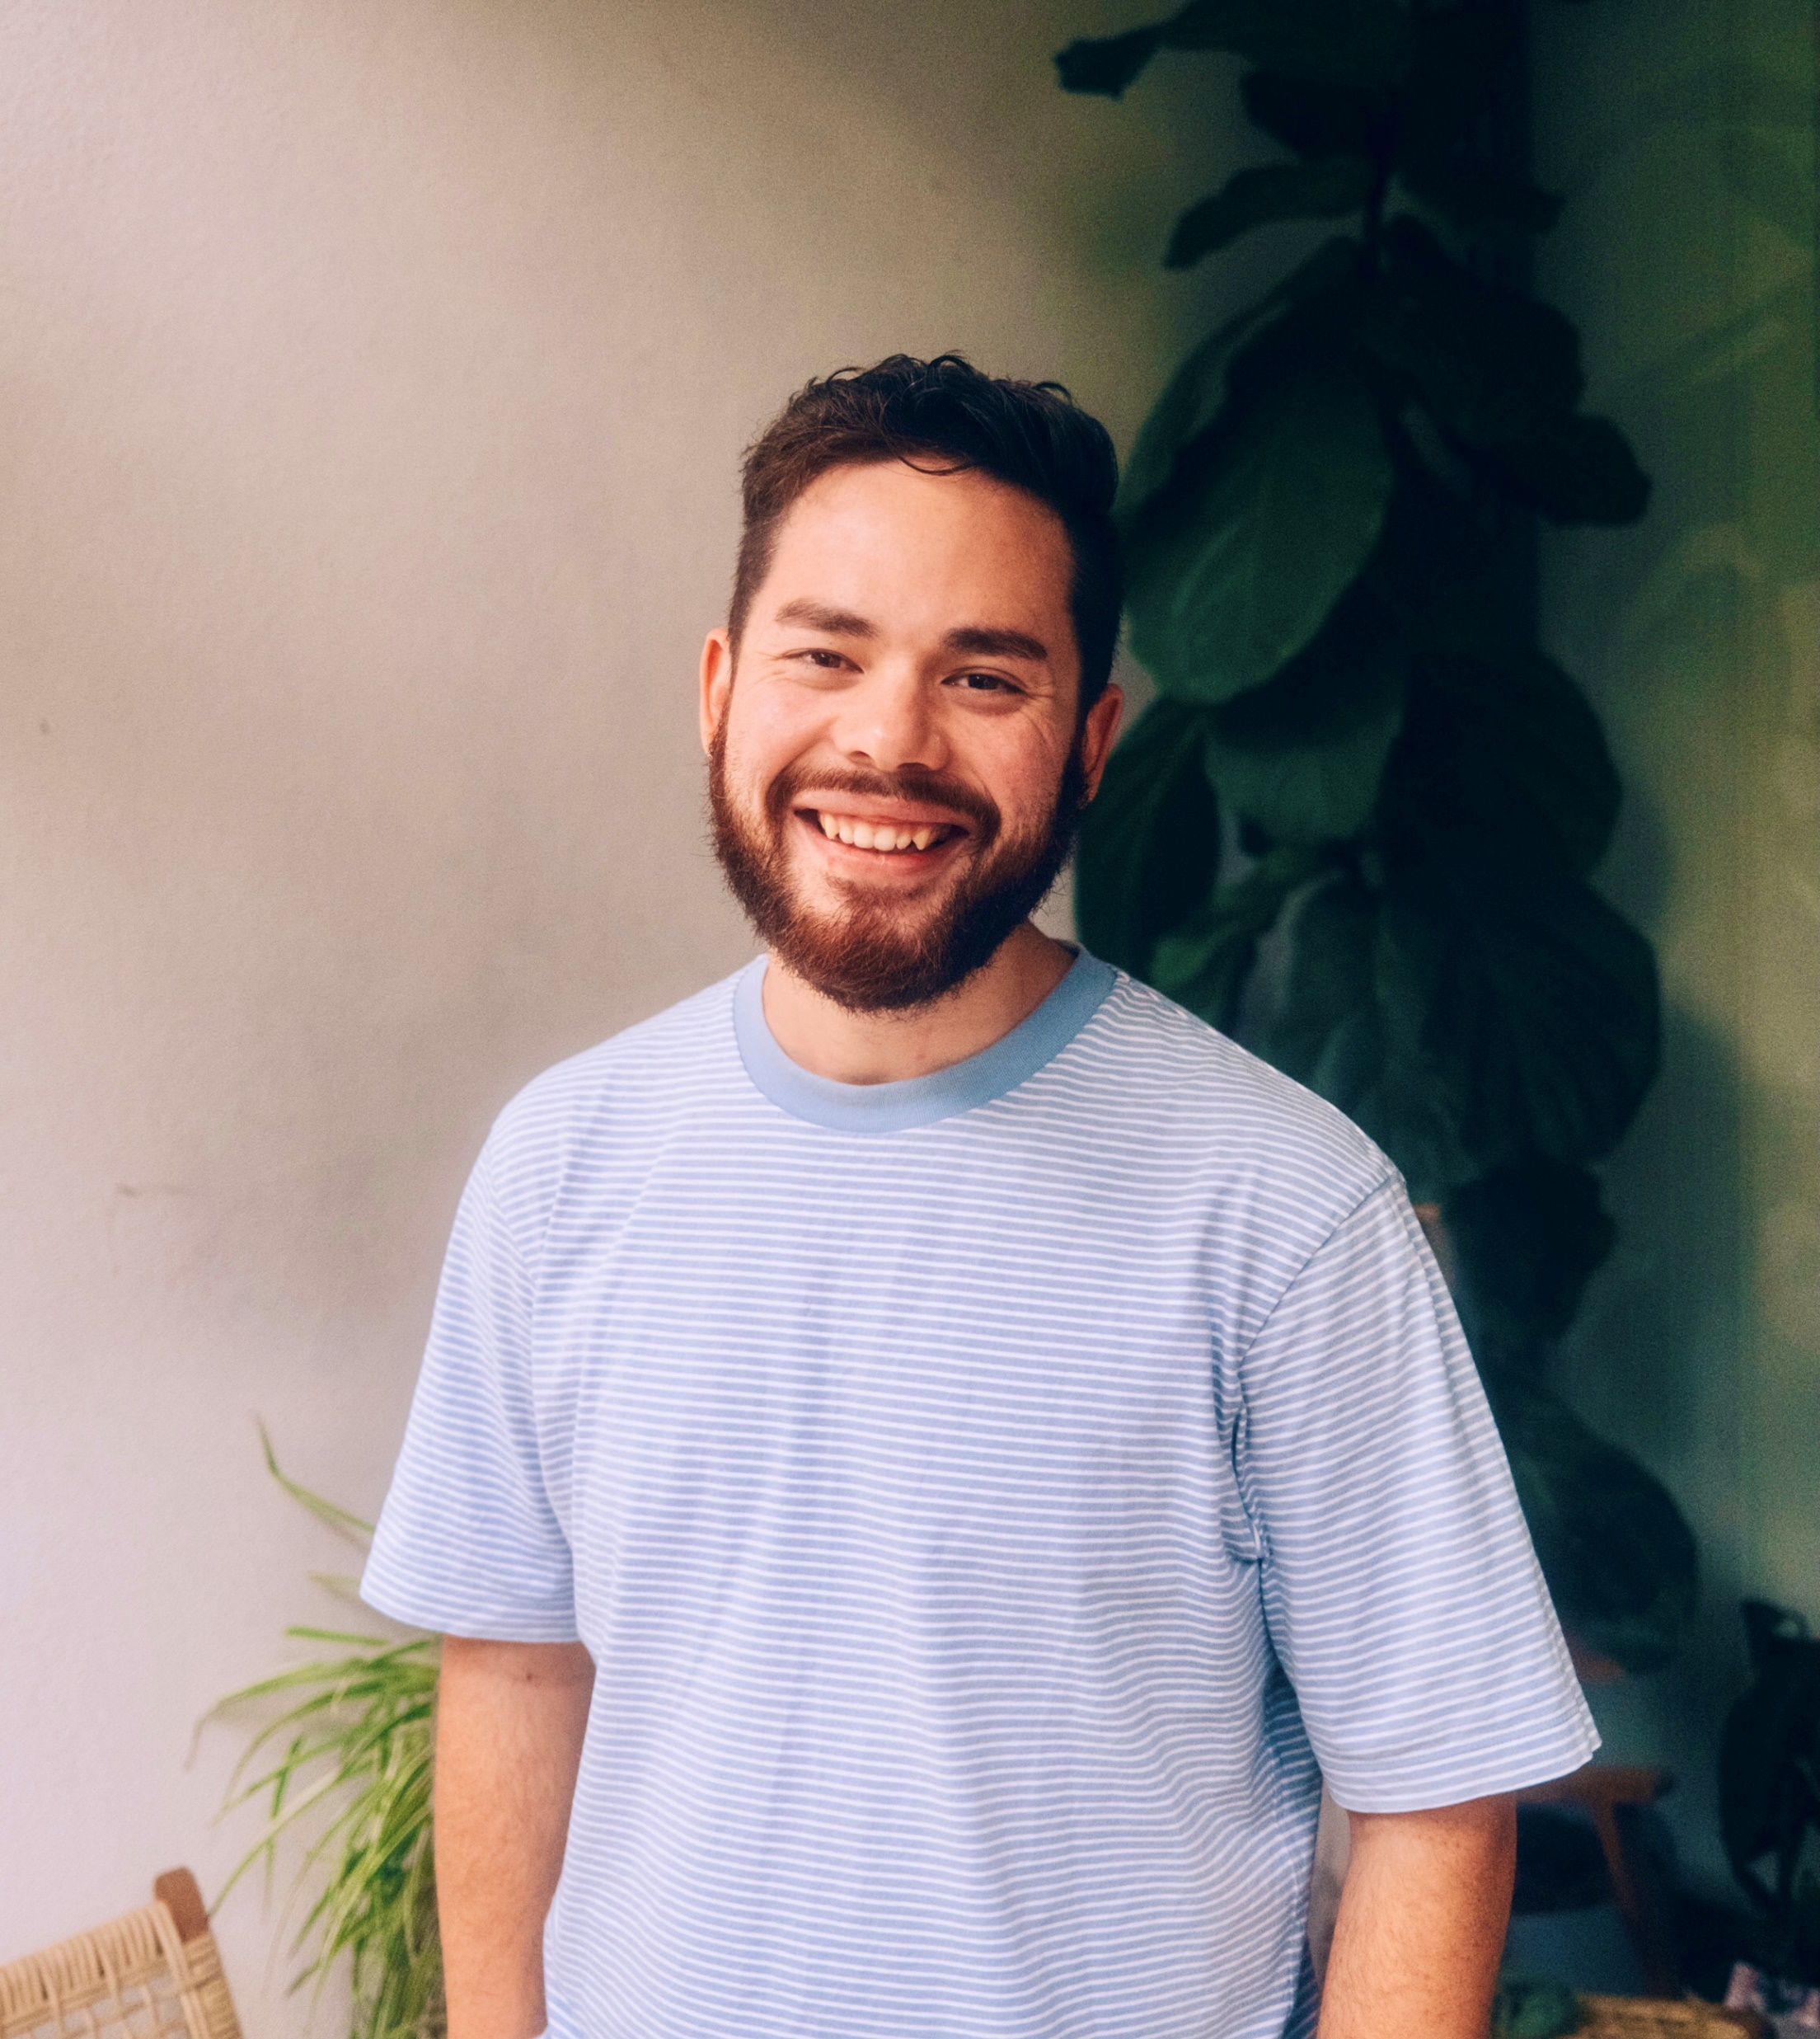


Your mental health is just as important as your physical health!
Moving to a new country is stressful. It’s not unusual for international students to feel anxious about study, work-life balance or personal issues
TALK to someone – a friend, your teacher, your doctor and remember we have counsellors
Timothy Dale
Confidential student
counsellor available: studentcounsellor@jcub.edu.au
13 11 14
1300 22 4636
MENTAL HEALTH

Slide 53

Working in Australia

Slide 54



Visit the Joblinx office
Assistance with your resume
Register with Joblinx email: info@joblinx.com.au
Open an Australian BANK ACCOUNT
Apply for TAX FILE NUMBER
Click for info

Slide 55
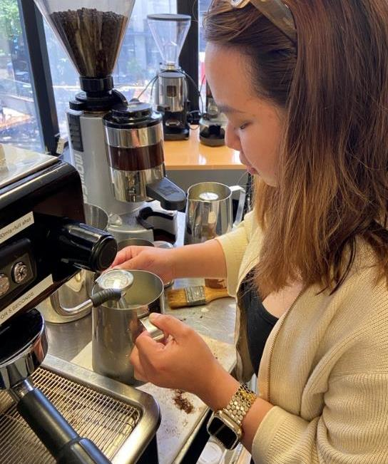
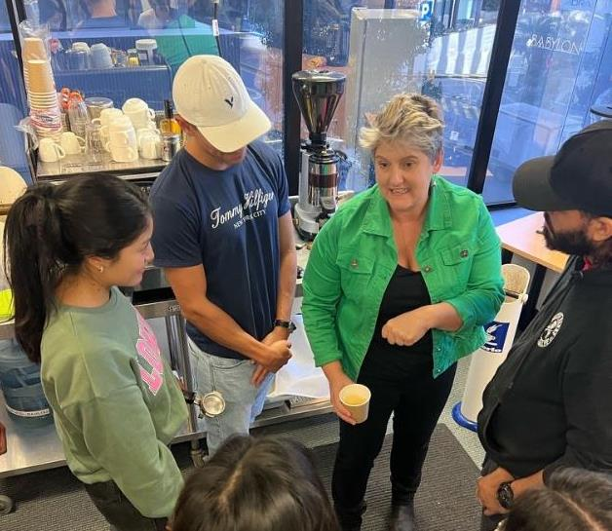
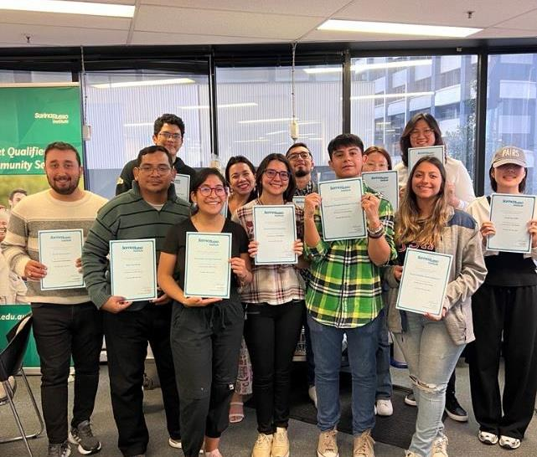


FREE courses available to assist you to gain skills to help you gain employment
Coffee making course
Hospitality course
WORK SKILLS

Slide 56

International students have the same rights in the workplace as Australian citizens.
The Fair Work Ombudsman can help with:
Questions about your pay
Work hours
Workplace bullying
Click for info

Slide 57
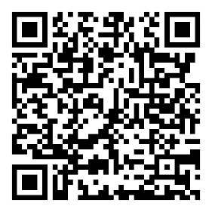



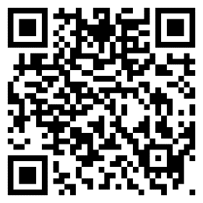

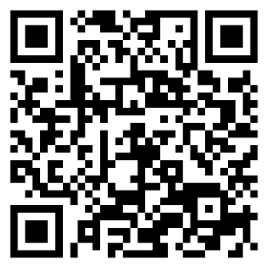

Protecting you at work

Slide 58
Contact Us
www.srienglish.edu.au
Admissions@sri.edu.au
English@sri.edu.au
Sarina Russo Institute
349 Queen Street, Brisbane
QLD 4000 Australia

Slide 59

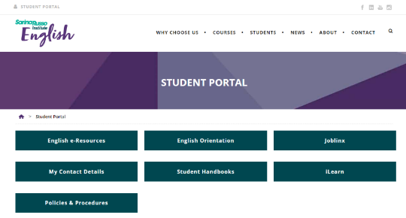

See you tomorrow!
Please review your orientation and student handbook! These are available to you anytime online

Slide 60


